Slide 1
Macrosociology
Rafael Marques

Slide 2
What is Macrosociology?
The sociological study of large-scale social systems and long-term patterns and processes. The branch of sociology concerned with the study of human societies on a wide scale
Societies, states, civilizations, cultures, religions, empires.
Wars, revolutions, colonizations.
Growth, progress, development, change.
Cycles, conversions, teleological processes, functions, structures.
Conflicts and consensus.
Geography, History, Comparison.

Slide 3
How to Study Macrosociology?
Comparative Historical Analysis.
Discovering Patterns and Regularities.
Finding Causal Mechanisms.
Paying Attention to Lucky and Random Dimensions.
Careful Use of Statistics.
Using Sociological Imagination.
Description, Explanation, and Prediction
Dangers of Oversimplification, Ethnocentrism, and Chronocentrism.

Slide 4
Some Examples of Macro Processes
Modernity and Modernization.
Rationality and Rationalization.
Democracy and Democratization.
Civilizing Process.
State Building.
Protests, Revolutions and Social Movements.
Mobilization.
Creating the Welfare State.

Slide 5
Historical macrosociology
Historical macrosociology can be understood as an approach that uses historical knowledge to try and solve some of the problems seen in the field of macrosociology. As globalization has affected the world, it has also influenced historical macrosociology, leading to the development of two distinct branches:
Comparative and Historical Sociology (CHS): a branch of historical macrosociology that bases its analysis on states, searching for "generalizations about common properties and principles of variation among instances across time and space." As of recently, it has been argued that globalization poses a threat to the CHS way of thinking because it often leads to the dissolution of distinct states.
Political Economy of the World-Systems (PEWS): a branch of historical macrosociology that bases its analysis on the systems of states, searching for "generalizations about interdependencies among a system's components and of principles of variation among systemic conditions across time and space."

Slide 6
Weberian Model of Capitalism

Slide 7
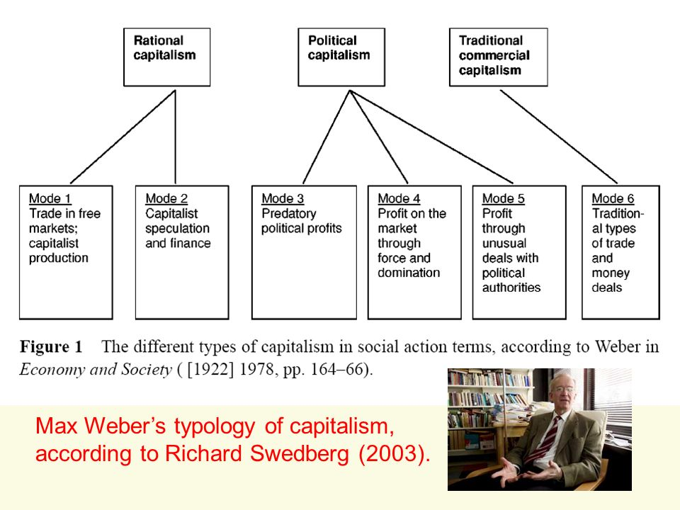
Weberian Model of Capitalism

Slide 8
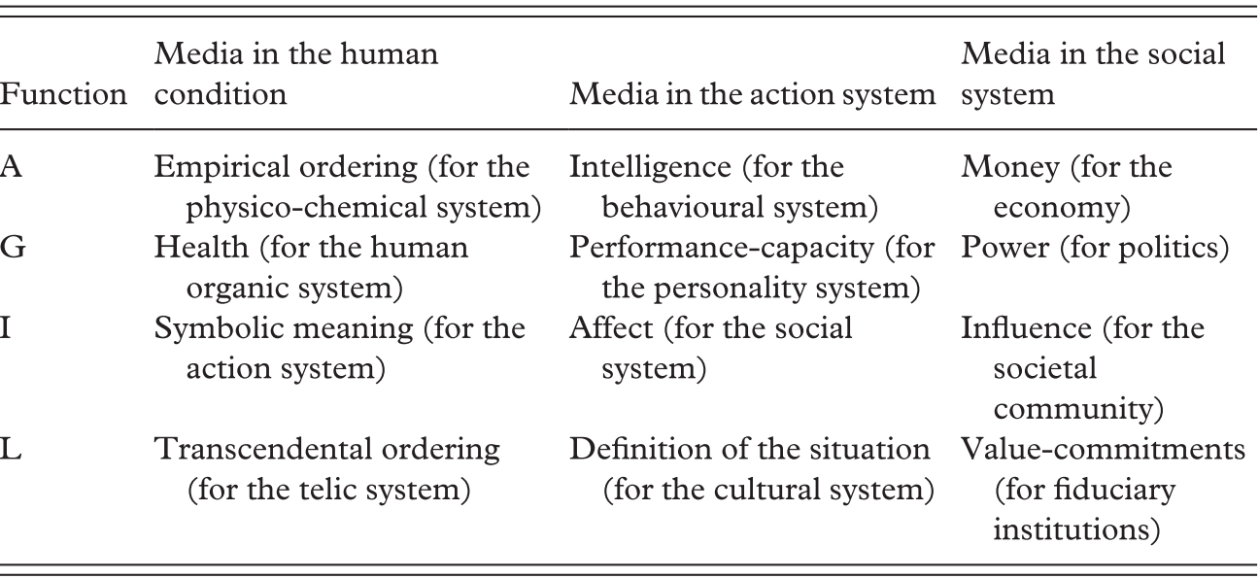
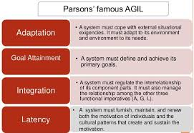
Parsons’s Agil System

Slide 9
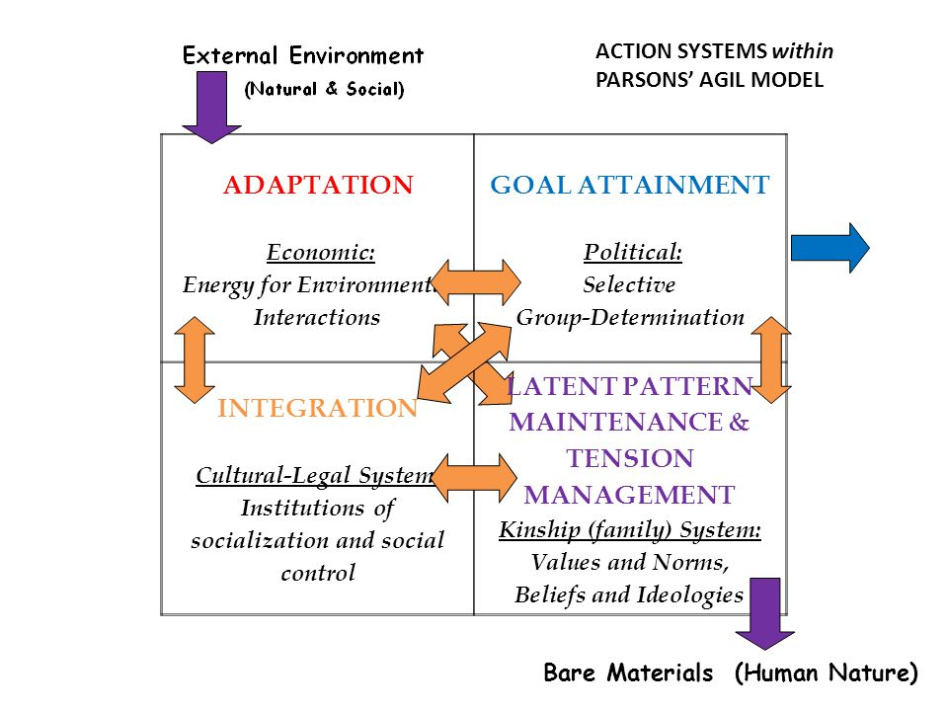
Parsons’s Agil System

Slide 10
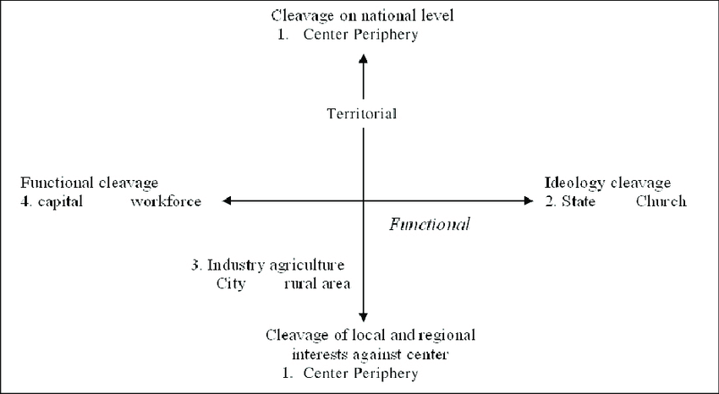
Cleavages and Dynamic Oppositions

Slide 11
Lipset and Rokkan

Slide 12
Modernization

Slide 13
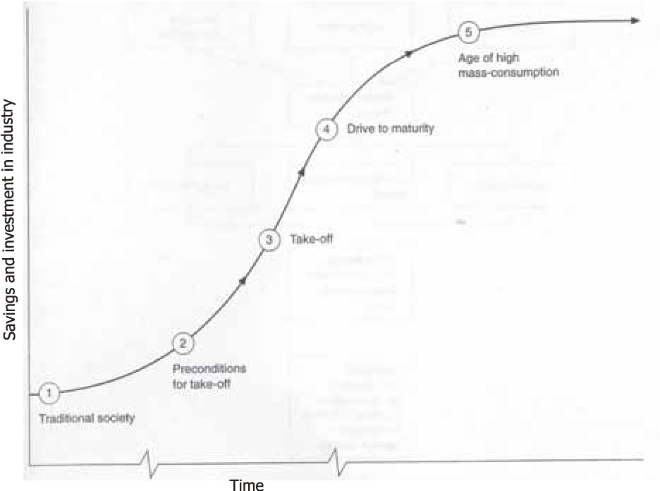
W.W. Rostow

Slide 15
Wallerstein’s Model
His most important work, The Modern World-System, appeared in four volumes between 1974 and 2011. In it, Wallerstein drew on several intellectual influences. From Karl Marx, Wallerstein took the underlying emphasis on economic factors and their dominance over ideological factors in global politics; and such ideas as the dichotomy between capital and labor; while criticizing the traditional Marxian view of world economic development through stages such as feudalism and capitalism, and while criticizing as well its account of the process of accumulation of capital, and of dialectics. From dependency theory, he took the key concepts of "core" and "periphery".

Slide 16
Wallerstein
Wallerstein's first volume on world-systems theory (The Modern World System, 1974). In it, he argues that the modern world system is distinguished from empires by its reliance on economic control of the world order by a dominating capitalist center (core) in systemic economic and political relation to peripheral and semi-peripheral world areas.
Wallerstein rejected the notion of a "Third World", claiming that there is only one world connected by a complex network of economic exchange relationships — i.e., a "world-economy" or "world-system" in which the "dichotomy of capital and labor" and the endless "accumulation of capital" by competing agents (historically including, but not limited, to nation-states) account for frictions.This approach is known as the world-system theory.
Wallerstein located the origin of the modern world-system in 16th-century Western Europe and the Americas. An initially slight advance in capital accumulation in Britain, the Dutch Republic, and France, due to specific political circumstances at the end of the period of feudalism, set in motion a process of gradual expansion. As a result, only one global network or system of economic exchange exists in modern society. By the 19th century, virtually every area on earth was incorporated into the capitalist world-economy. The capitalist world-system is far from homogeneous in cultural, political, and economic terms; instead, it is characterized by fundamental differences in social development, accumulation of political power, and capital. Contrary to affirmative theories of modernization and capitalism, Wallerstein did not conceive of these differences as mere residues or irregularities that can and will be overcome as the system evolves.

Slide 17
The Modern World-System
A lasting division of the world into core, semi-periphery, and periphery is an inherent feature of world-system theory. Other theories, partially drawn on by Wallerstein, leave out the semi-periphery and do not allow for a grayscale of development. Areas which have so far remained outside the reach of the world-system enter it at the stage of "periphery". There is a fundamental and institutionally stabilized "division of labor" between core and periphery: while the core has a high level of technological development and manufactures complex products, the role of the periphery is to supply raw materials, agricultural products, and cheap labor for the expanding agents of the core. Economic exchange between core and periphery takes place on unequal terms: the periphery is forced to sell its products at low prices, but has to buy the core's products at comparatively high prices. Once established, this unequal state tends to stabilize itself due to inherent, quasi-deterministic constraints. The statuses of core and periphery are not exclusive and fixed geographically, but are relative to each other. A zone defined as "semi-periphery" acts as a periphery to the core and as a core to the periphery. At the end of the 20th century, this zone would comprise Eastern Europe, China, Brazil, and Mexico. It is important to note that core and peripheral zones can co-exist in the same location.
One effect of the expansion of the world-system is the commodification of things, including human labor. Natural resources, land, labor, and human relationships are gradually being stripped of their "intrinsic" value and turned into commodities in a market which dictates their exchange value.

Slide 18
Terms and definitions
Capitalist world-system - Wallerstein's definition follows dependency theory, which intended to combine the developments of the different societies since the 16th century in different regions into one collective development. The main characteristic of his definition is the development of a global division of labour, including the existence of independent political units (in this case, states) at the same time. There is no political center, compared to global empires like the Roman Empire; instead, the capitalist world-system is identified by the global market economy. It is divided into core, semi-periphery, and periphery regions, and is ruled by the capitalist mode of production.
Core/periphery - Defines the difference between developed and developing countries, characterized e.g. by power or wealth. The core refers to developed countries, the periphery to the dependent developing countries. The main reason for the position of the developed countries is economic power.
Semi-periphery - Defines states that are located between core and periphery, and who benefit from the periphery through unequal exchange relations. At the same time, the core benefits from the semi-periphery through unequal exchange relations.
Quasi-monopolies - Defines a kind of monopoly where there is more than one service provider for a particular good/service. Wallerstein claims that quasi-monopolies are self-liquidating because new sellers go into the market by exerting political pressure to open markets to competition.
Kondratiev waves - A Kondratiev wave is defined as a cyclical tendency in the world's economy. It is also known as a supercycle. Wallerstein argues that global wars are tied to Kondratiev waves. According to him, global conflicts occur as the summer phase of a wave begins, which is when production of goods and services around the world are on an upswing.

Slide 22
Development

Slide 23
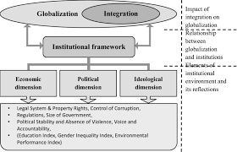
Globalization

Slide 24
Norbert Elias
Elias' theory focused on the relationship between power, behavior, emotion, and knowledge over time. He significantly shaped what is called process or figurational sociology.
The first volume, The History of Manners, traces the historical developments of the European habitus, or "second nature", the particular individual psychic structures molded by social attitudes. Elias traced how post-medieval European standards regarding violence, sexual behaviour, bodily functions, table manners and forms of speech were gradually transformed by increasing thresholds of shame and repugnance, working outward from a nucleus in court etiquette. The internalized "self-restraint" imposed by increasingly complex networks of social connections developed the "psychological" self-perceptions that Freud recognized as the "super-ego".

Slide 25
Norbert Elias
The second volume, State Formation and Civilization, looks into the formation of the state and the theory of civilization. First, Elias explains that throughout time, social unity increased its control over military and fiscal power until possessing the monopoly over it. The progressive monopolization of the military and taxation were feeding another (the political power was using tax money to pay its army and using the army to collect the taxes). Elias describes several steps of the creation of the State:
From the 11th to the 13th c.: there was an open competition between different houses where everyone was fighting to maintain and extend its power. For instance, after the death of Charles IV of France (1328), France formed a powerful agglomeration of territories. However, one cannot speak of a coherent kingdom yet because regional consciousness was still predominant, the interests of each territory and seigneury were prevailing. From the 14th to the 16th c.: the courts were progressively established, and vassals gathered around important lords. The feudality was princely (it was seigneurial before) because only the most powerful houses had maintained their power and extended it by taking over the territory of smaller houses. After the 16th c.: the royal house is victorious and has a monopoly of power. It created a central administration and institutions. The competitions were now regulated: it takes place peacefully within the state to access a high position in the administration. At the end of the process, the State is created and possessed the monopoly of legitimate physical violence. Elias also describes that the "absolutist mechanism": the state became the supreme body that coordinates the different interdependent group of the society. In parallel of the sociogeneses of the state, Elias notes the change in the way to manage the bodily functions. Individuals tried to repress in themselves what is perceived to be part of animal nature, repress in a sphere that appears through time, intimacy. Hence, new feelings appeared: embarrassment and prudishness.

Slide 27
Tilly’s Model of State Formation
Examining political, social, and technological change in Europe from the Middle Ages to the present, Tilly attempted to explain the unprecedented success of the nation-state as the dominant polity-type on Earth in his 1990 book Coercion, Capital, and European States.
Tilly focused his attention on Europe after the decline of the Roman Empire. During this period, state organization was mostly informal and the work of local lords who controlled relatively small areas. Peasants gave up revenue in order to benefit from the security and protection offered by a powerful local lord. Over time, these feudal lands consolidated and required bigger armies in order to offer protection from both internal and external threats. Larger armies proved more effective and subsequently, more money was needed to pay these armies. Feudal lands continued to develop and combine into larger kingdoms ruled by kings. Kings then demanded money in the form of taxes. To impose these taxes, they required a protocol for counting and enforcing collections, so they set up formal state institutions.

Slide 28
Tilly’s State Activities
Tilly argues that states carry out the following four activities:
War making: The act of eliminating rivals or potential external threats outside of its own territories.
State making: The act of eliminating internal rival forces and insurgents from within its own territories.
Protection: The act of eliminating potential threats to their population.
Extraction: The act of securing the means to execute the previous three activities, such as the collection of taxes or revenue.
These four activities can take on a number of forms, and Tilly was interested in examining these activities through the lens of organized violence, claiming that these activities are analogous to protection rackets carried out by organized criminal organizations. This comprises a predatory theory of state-building.

Slide 29
The Three Worlds of Welfare Capitalism
In The Three Worlds of Welfare Capitalism, Esping-Andersen outlines a typology of welfare capitalism in an attempt to classify contemporary Western welfare states as belonging to one of three "worlds of welfare capitalism." The three types are characterised by a specific labour market regime and also by a specific post‐industrial employment trajectory.
Liberal regimes, characterized by modest, means-tested assistance, and targeted at low-income, usually working-class recipients. Their strict entitlement rules are often associated with stigma. This type of welfare state encourages market solutions to social problems — either passively, by guaranteeing only a minimum, or actively, by directly subsidizing private welfare schemes.
Conservative regimes, which are typically shaped by traditional family values, and tend to encourage family-based assistance dynamics. Social insurance in this model typically excludes non-working wives, and family benefits encourage motherhood. State assistance will typically only step in when the family's capacity to aid its members is exhausted.
Social democratic regimes, universalistic systems that promote an equality of high standards, rather than an equality of minimal needs. This implies decommodifying welfare services, to reduce the division introduced by market-based access to welfare services, as well as preemptively socializing the costs of caring for children, the aged, and the helpless, instead of then waiting until the family's capacity to support them is depleted. This results in a commitment to a heavy social service burden, which introduces an imperative to minimize social problems, thereby aligning the system's goals with the welfare and emancipation (typically via full employment policies) of those it supports.

Slide 30
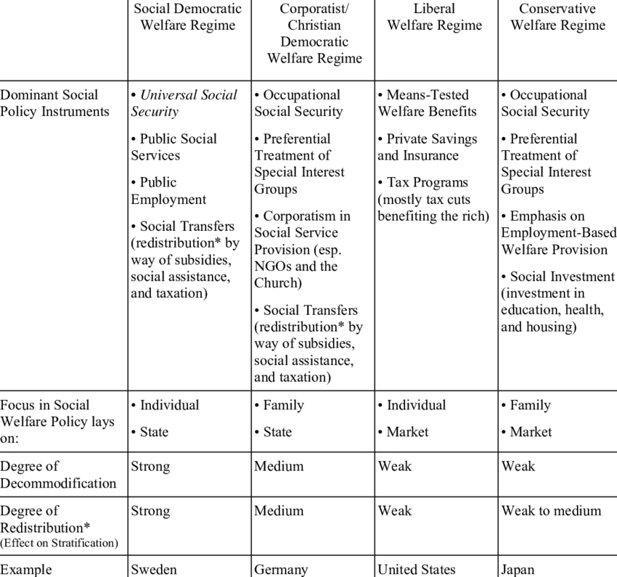
Welfare State Regimes

Slide 31
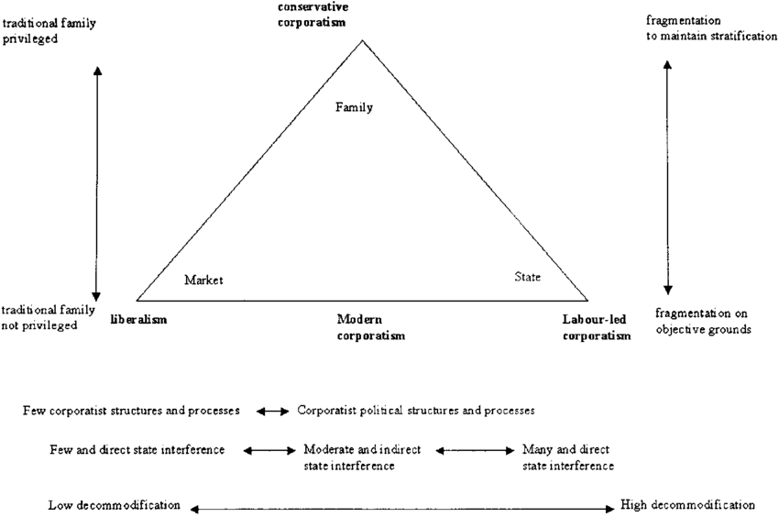
Welfare State Regimes

Slide 32
Moore’s The Origins of Dictatorship and Democracy
Moore's groundbreaking work Social Origins of Dictatorship and Democracy (1966) was the cornerstone to what is now called comparative historical analysis in the social sciences. In that work he studied the conditions for the sociogenesis of democratic, fascist and communist regimes, looking especially at the ways in which industrialization and the pre-existing agrarian regimes interacted to produce those different political outcomes. He drew particular attention to the violence which preceded the development of democratic institutions. Moore lists five conditions for the development of Western-style democracy (through a "bourgeois revolution"):
the "development of a balance to avoid too strong a crown or too independent a landed aristocracy“.
a shift toward "an appropriate form of commercial agriculture“.
a "weakening of the landed aristocracy“.
the "prevention of an aristocratic-bourgeois coalition against the peasants and workers" [which would lead to fascism].
a "revolutionary break with the past".

Slide 33
Moore’s The Origins of Dictatorship and Democracy
Moore's concern was the transformation of pre-industrial agrarian social relations into "modern" ones. He highlighted what he called "three routes to the modern world" - the liberal democratic, the fascist, and the communist - each deriving from the timing of industrialization and the social structure at the time of transition. In the simplest sense, Social Origins can be summarized with his famous statement "No bourgeois, no democracy“ although taking that idea at face value undercuts and misinterprets the nuances of his argument.
In England, the effect of the "bourgeois impulse" was to change the attitudes of a portion of the landed elite towards commercial farming, leading to the destruction of the peasantry through the enclosure system and the English Civil War which led to an aristocratic, but moderate democracy.
In France, the French Revolution did directly include the bourgeoisie, but it was the overwhelming influence of the peasantry that determined "just how far the revolution could go." The peasantry remained thereafter a reservoir of reactionary attitudes.
In the United States, the industrial north's victory over the Southern planter elite in the Civil War cemented the U.S. path to modernity through liberal democracy, but only after southern planters "acquired a tincture" of urban business - essentially changing their attitudes towards capitalist accumulation. The result, however, was that once this transformation took place, the Northern capitalists ended Reconstruction and allowed the South to implement Jim Crow.

Slide 34
Moore’s The Origins of Dictatorship and Democracy
Moore also directly addressed the Japanese transition to modernity through fascism and the communist path in China, while implicitly remarking on Germany and Russia.
For Moore, the influence of the bourgeoisie in Japan was significantly more limited than in England, France, and the U.S. Instead of the capitalist accumulation through the "bourgeois impulse" as it did in those three cases, Japan's late transition to industrial modernity was induced through "labor repressive" agriculture - squeezing the peasantry to generate the necessary capital for modernization. This "revolution from above" served to cement a reactionary alliance of a weak bourgeoisie and powerful landowners that culminated in fascism.
In China, the overwhelming strength of the peasantry vis-a-vis the bourgeoisie and the landed elites resulted in the Chinese Revolution, but they were its first victims. Here, the bourgeoisie allied with the peasants, and created a "revolution from below." Moore criticized attempts by other sociologists to retroactively identify some kind of useful "function" served by the Chinese system of imperial government, and argued that the more likely reason for its prolonged survival was that most people, especially peasants, simply accept their social system "unless and until something happens to threaten and destroy their daily routine."
One can see Moore's theme of the bourgeoisie again here - in the states that became democratic, there was a strong bourgeoisie. In Japan and China, the bourgeoisie was weak, and allied with the elites or peasants to create fascism or communism, respectively.

Slide 36
Theda Skocpol’s View
States and Social Revolutions (1979)
Skocpol’s most famous book, States and Social Revolutions: A comparative Analysis of Social Revolutions in Russia, France and China (1979), discusses how most theories account only for direct action in bringing about revolutions. Social Revolutions are fast-paced foundational transformations of society's state and class structures. She includes the structure involved in creating a revolutionary situation that can lead to a social revolution - one that changes civic institutions and government once the administration and military branches collapse.
In her text, Skocpol "offers a framework of reference for analyzing social-revolutionary transformations in modern world history" and discusses and compares the causes of The "French Revolution" of 1787–1800, The Russian Revolution of 1917–1921, and The Chinese Revolution of 1911–1949.

Slide 37
Theda Skocpol
According to Skocpol, there are two stages to social revolutions: a crisis of state and the emergence of a dominant class to take advantage of a revolutionary situation. The crisis of state emerges from poor economy, natural disaster, food shortage, or security concerns. Leaders of the revolution also have to face these constraints, and their handling of them affects how well they re-establish the state.
Skocpol uses Marxism’s class struggle to assert that the main causes of social unrest are state social structures, international competitive pressures, international demonstrations, and class relations. Critics suggest that Skocpol ignores the role of individuals and ideology and uses varied comparative methodological strategies.
State Autonomy Theory - Before she wrote Protecting Soldiers and Mothers, Skocpol first devised what she termed State Autonomy Theory. This theory underlined the idea that state bureaucracies could have the potential for autonomous operations, and that this potential was ignored by scientists who were focused on society-centric studies. Skocpol considers the idea that parties are more important in America than the government, and that class dominance plays heavily into American politics.

Slide 38
Theda Skocpol

